Slide 1
Rights and Duties
By
Muhammad Sajid
Lecturer SIBA University

Slide 2
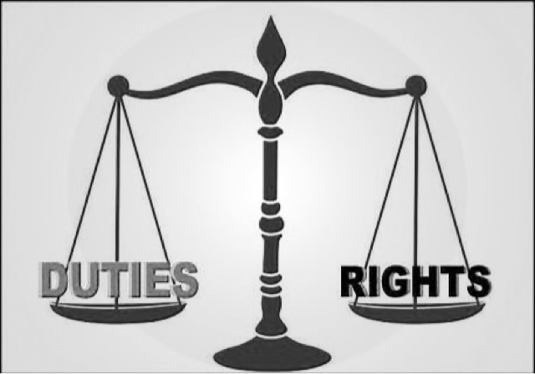
Brainstorming

Slide 3
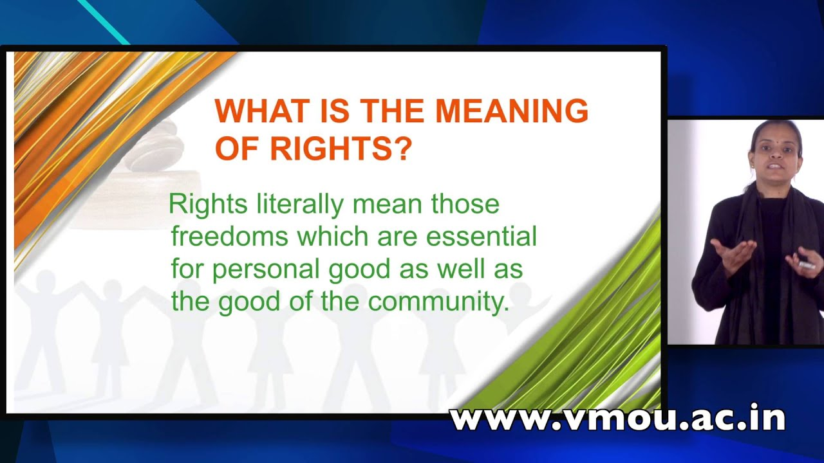
Meaning of Rights

Slide 4
Relationship between Rights and Duties
Rights and duties go together.
My right is other’s duty.
Rights without duties are not possible.

Slide 5
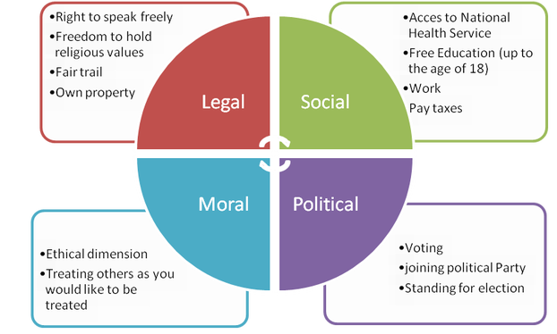
Some important rights

Slide 6
Some essential duties/responsibilities
Do the work honestly.
Stay informed of the issues affecting your community.
Participate in the democratic process.
Respect and obey federal, state, and local laws.
Respect the rights, beliefs, and opinions of others.
Participate in your local community.
Pay income and other taxes honestly, and on time, to federal, state, and local authorities.
Serve on a jury when called upon.
Defend the country if the need should arise.

Slide 7
Qs & As
Class Discussion

